Slide 1
Classification of Negative Emotions in Online Comments
Machine Learning (1002)
Group 25
谢欣言 1930026136
焦海旭 1930026057

Slide 2
TABLE OF CONTENTS
01
02
03
Topic & Background
Our Dataset
Data Preprocessing
04
05
06
Models & Algorithms
Results Analysis
Application of Models

Slide 3
01
Topic & Background

Slide 4
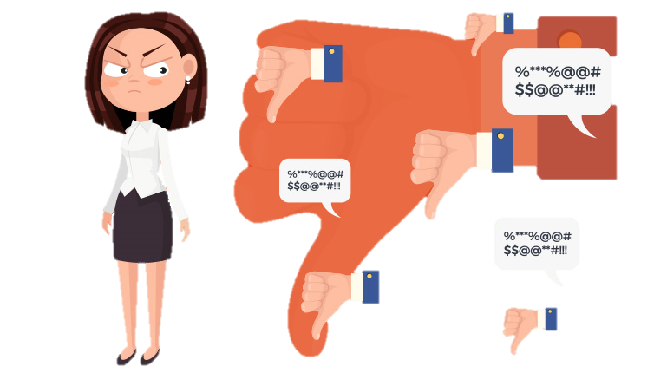
Topic & Background
As network is quite developed today, many people are suffering from cyber violence in the form of hate speeches and toxic comments, from whom we usually call “Keyboard warriors”.
Therefore, it’s necessary to detect these toxic comments and determine the nature of their negative emotions to remove them from websites, which can be thought as a multi-class and multi-label classification task.

Slide 5
Survey on Existing Techniques
Bagging: Random Forest, Extra Tree Boosting: AdaBoost, XGBoost
SVM, Decision Tree, Logistic Regression
Natural Language Processing
Nural Networks
Classification
Ensemble Learning
BP, RNN, LSTM
TFIDF, Glove, fastText, word2vec, USE

Slide 6
Our Dataset
02

Slide 7

Source
Our dataset was found from: https://www.kaggle.com/c/jigsaw-toxic-comment-classification-challenge
It contains 3 files:
test.csv, test_labels.csv, train.csv.

Slide 8
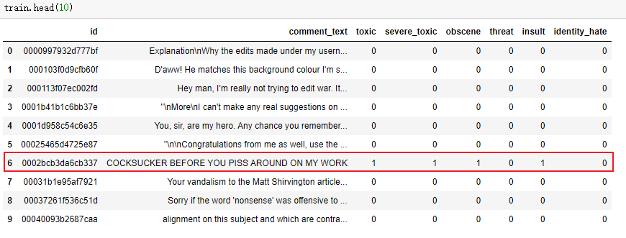
Data Structure
6 labels for negative comments
Clean comments
Negative comment with “toxic”, “severe_toxic”, “obscene”, “insult” labels

Slide 9
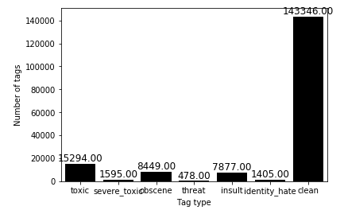
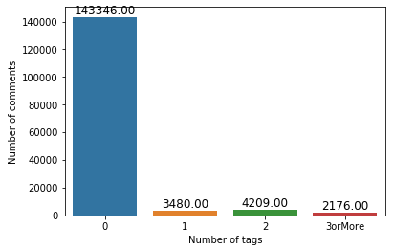
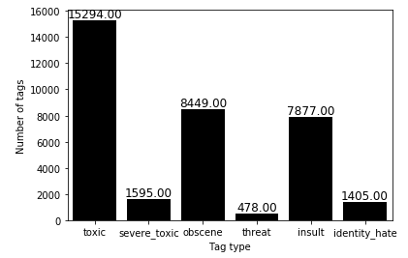
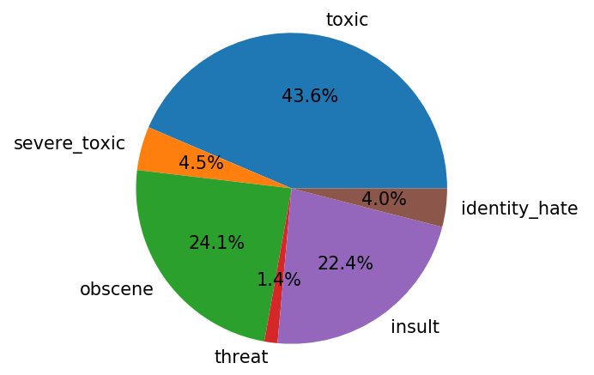
Data Visualization
Unbalanced dataset: Most are “clean”

Slide 10
03
Data Preprocessing

Slide 11
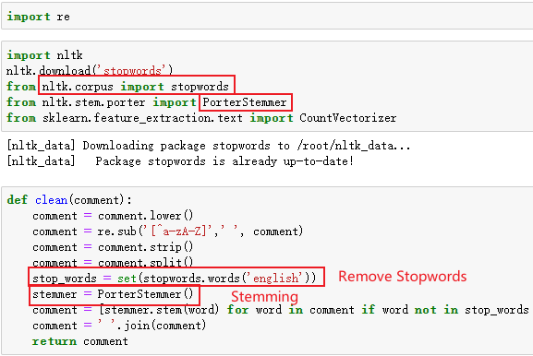
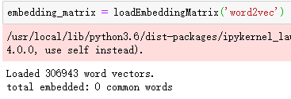
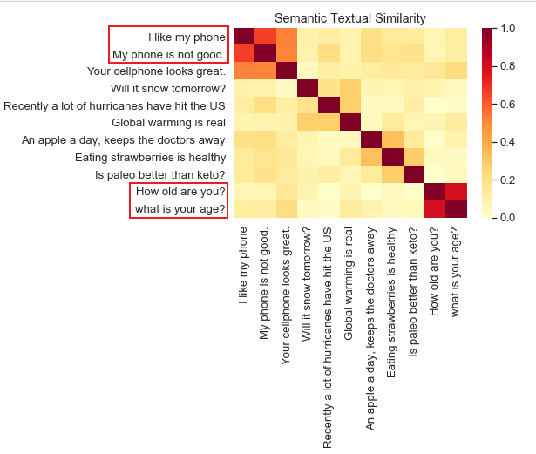
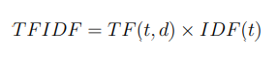
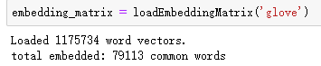
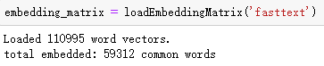
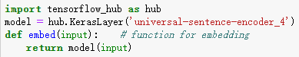
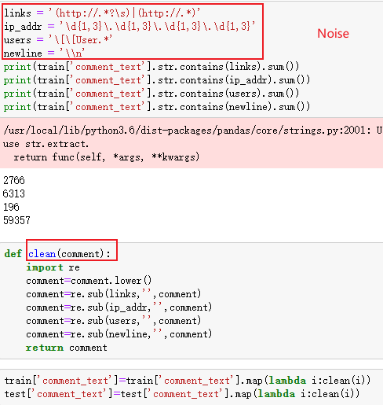
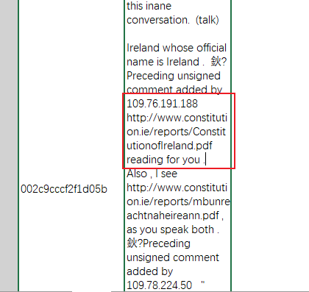
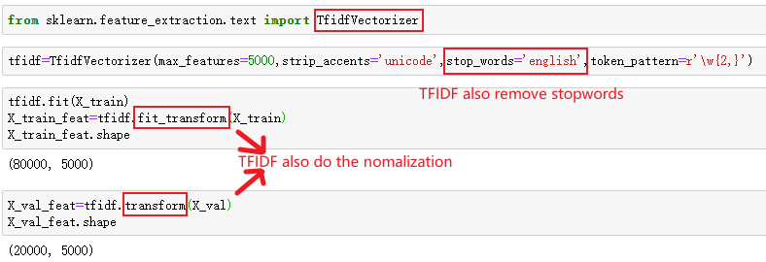
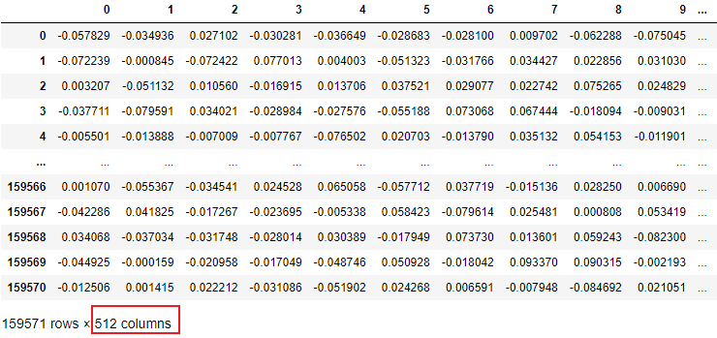
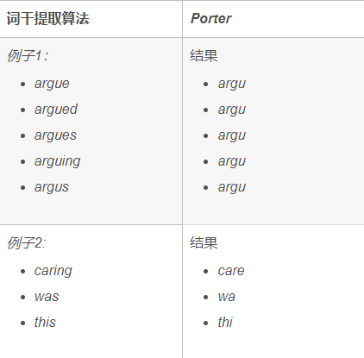
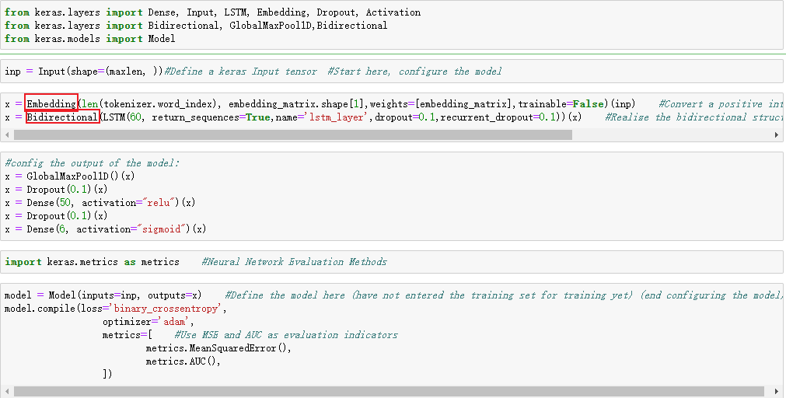
Data Preprocessing
Remove noise
Stopwords & Stemming
Natrual Language to Vectors
USE
(Universal Sentence Encoder)
TFIDF
Word Embeddings
(Glove, fastText, word2vec)
512 dimensions!

Slide 12
04
Models & Algorithms

Slide 13
Logistic Regression (implemented by ourselves)

Slide 14
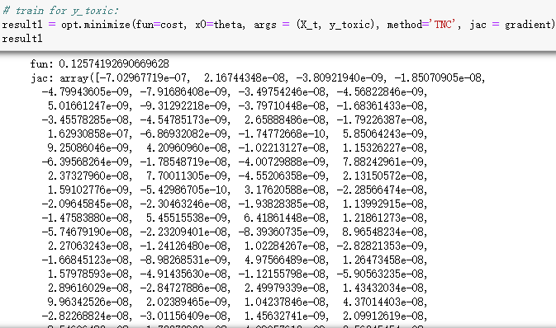
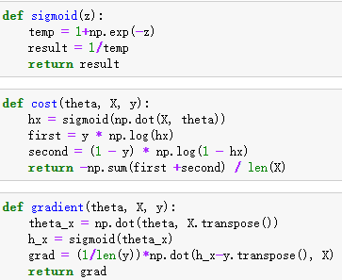
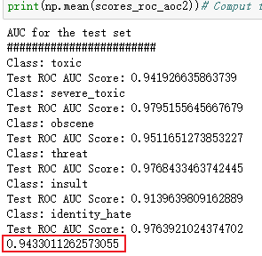
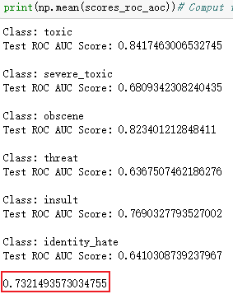
Logistic Regression
USE
TFIDF
USE is much better!

Slide 15
BP Neural Network (implemented by ourselves)

Slide 16
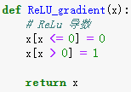
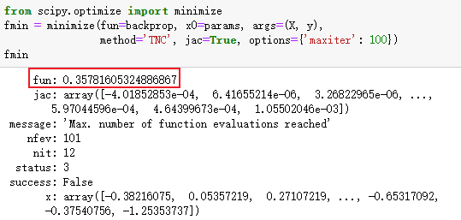
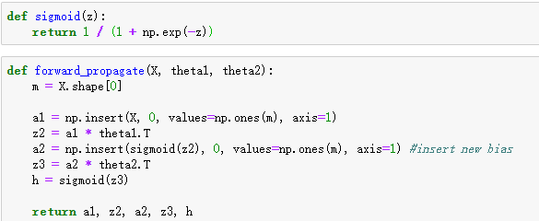
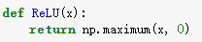
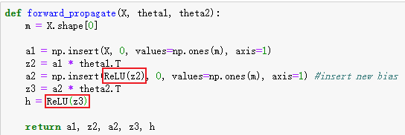
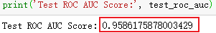
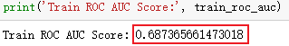
BP Neural Network (Using USE)
Sigmoid:
ReLU:

Slide 17
LSTM

Slide 18
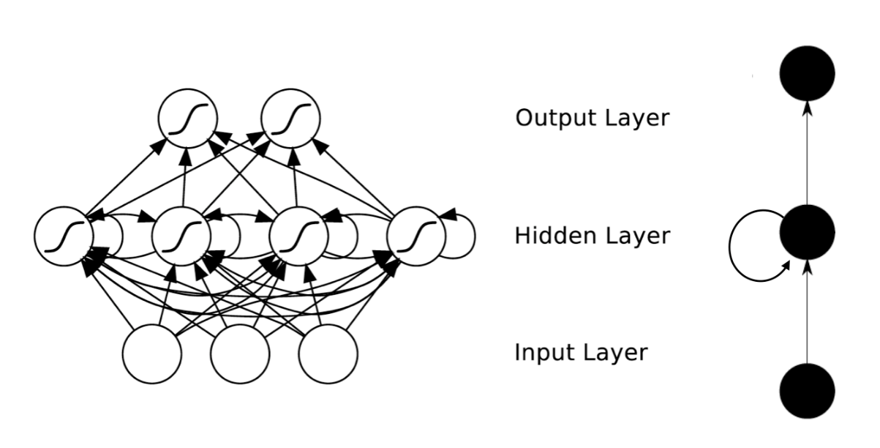
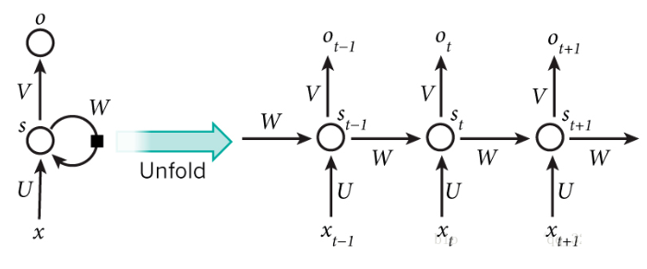

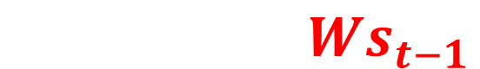
RNN (Recurrent Neural Network)
The network “remembers” the previous information and applies it to the computation of the current layer.
Unfold the hidden layer
$$h_{t}=Ux_{t}+Ws_{t−1}$$
Current input
Past memory
summary

Slide 19
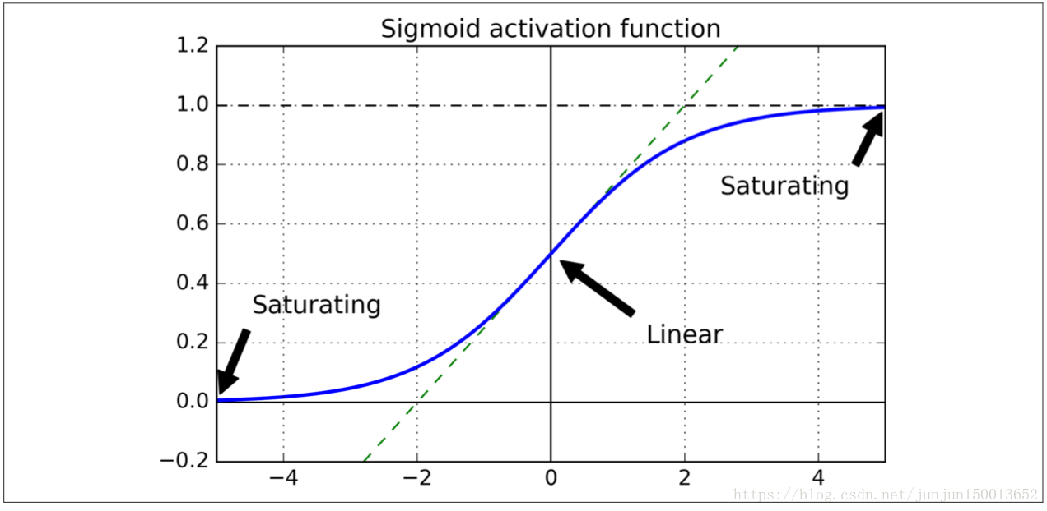

RNN (Recurrent Neural Network)
Gradient explosion/disappearance:
In RNN, if the gradient between each step is too large/small (or using an improper activation function such as sigmoid), the gradient will become too large or 0.

Slide 20
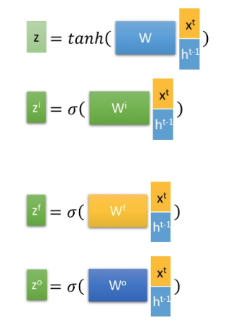
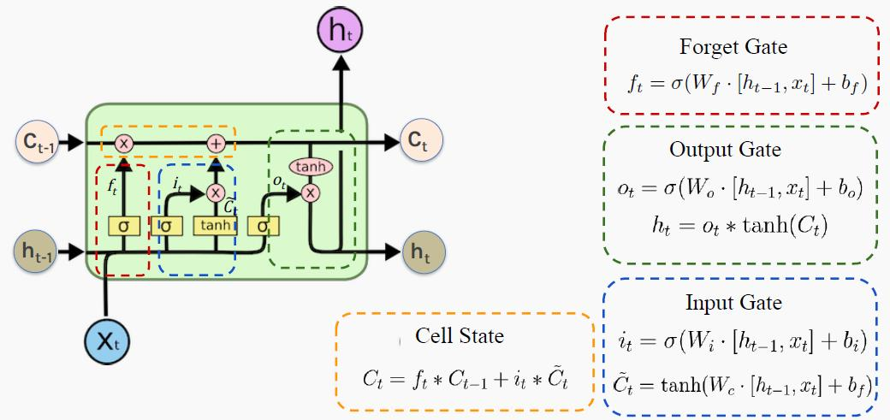
LSTM (Long Short-Term Memory)
The previous "memories" are stored through special gate structures:

Slide 21
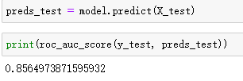
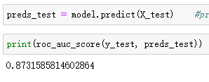
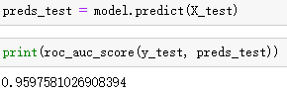
LSTM (Long Short-Term Memory)
word2vec
Glove
fastText

Slide 22
Ensemble Learning

Slide 23
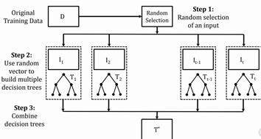
Bagging: Extra-Trees
Extra-Trees are extension of Bagging and are very similar to random forest.

Slide 24
Bagging: Extra-Trees
Compared with the random forest:
Extra Tree generally does not use random sampling, that is, each decision tree uses the original training set.
Random Forest will select the best features based on principles such as Gini index. While extra tree will randomly selects the features to generate leaves.

Slide 25
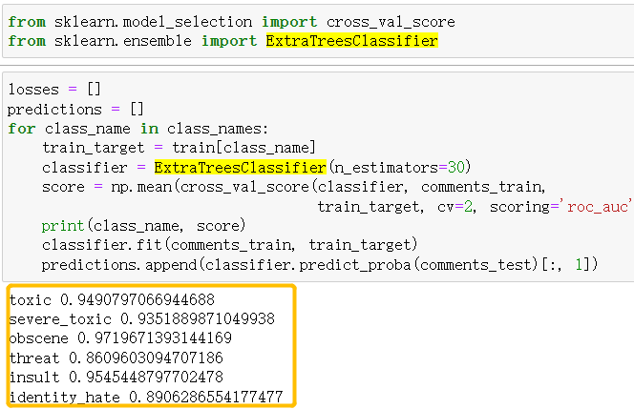
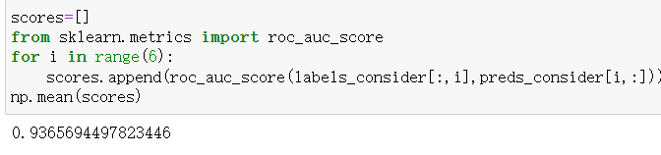
Bagging: Extra-Trees
Compared with Random Forest, the variance of the Extra tree decreases, but the bias increases.

Slide 26
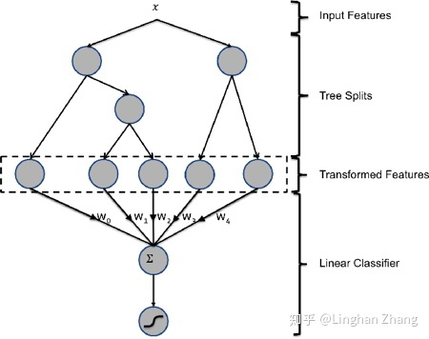
Boosting: XGBoost
XGBoost (eXtreme Gradient Boosting) is an algorithm based on GBDT (Gradient Boosting Decision Tree). It is an additive model based on Boosting inheritance idea.

Slide 27
Boosting: XGBoost
GBDT model adopts forward distribution algorithm for greedy learning during training.
Each iteration of XGBoost learns a CART (classification and regression tree) to fit the residuals between the predicted results of the previous T-1 trees and the true values.

Slide 28
Boosting: XGBoost
Compared with the Adaboost we learned:
The base learner of XGBoost is a decision tree, while AdaBoost can use a variety of other weak learners.
XGBoost's objective function consists of a loss function and a regularization term which describe complexity. While AdaBoost has no regularization term.

Slide 29
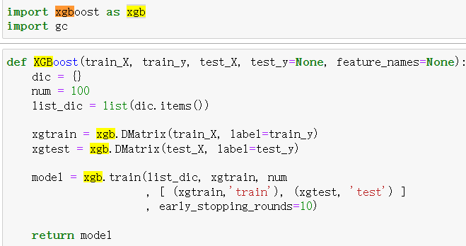
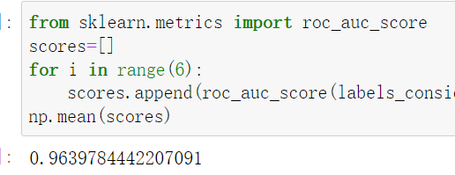
Boosting: XGBoost

Slide 30
SVM

Slide 31
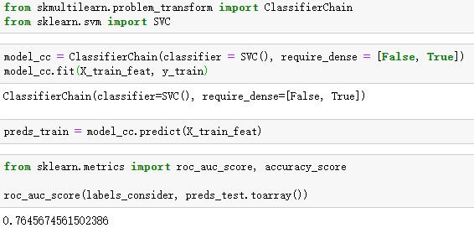
SVM

Slide 32
05
Results Analysis

Slide 33
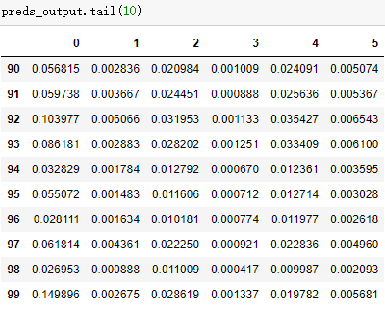
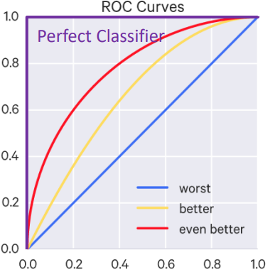
ROC-AUC Score
Better than “accuracy” for probability results.

Slide 34
Results
Model | Mean AUC_ROC Score
XGBoost (TFIDF) | 0.96
LSTM (FastText) | 0.96
BP NN (USE) | 0.95
Logistic Regression (USE) | 0.94
Extra Trees (TFIDF) | 0.93
LSTM (Glove) | 0.88
LSTM (Word2Vec) | 0.85
Logistic Regression (TFIDF) | 0.73

Slide 35

Speed V.S. Accuracy
TFIDF
USE
Speed: 10s for 150,000 records
Accuracy: 0.96 in XGBoost
0.73 in Logistic Regression
Speed: 30min-1h for 150,000 records
Accuracy: (???)REALLY SLOW in XGBoost, 0.95 in Logistic Regression
Efficiency: accurate enough & fast

Slide 36
06
Application of Models

Slide 37




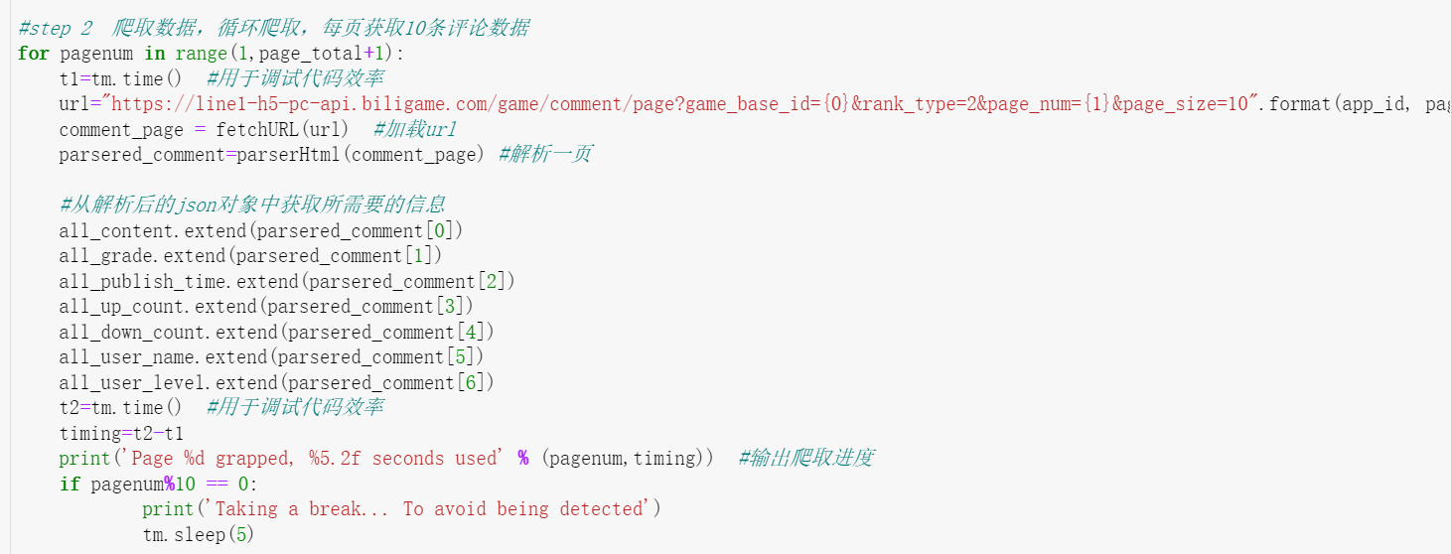

Dataset We Crawled

Slide 38
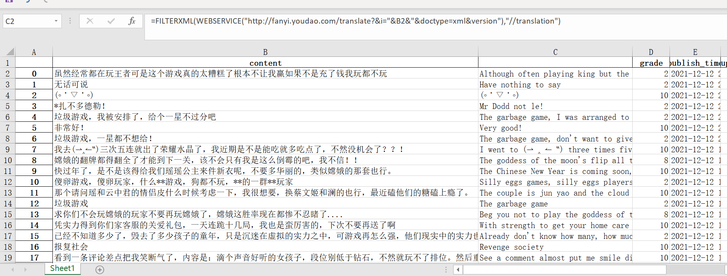

Predicted Results
Translate into English
Predict using XGBoost (Probabilities)

Slide 39
THANKS

Slide 40

Reference
Sundermeyer, M., Schlüter, R., & Ney, H. (2012). LSTM neural networks for language modeling. In Thirteenth annual conference of the international speech communication association.
Merity, S., Keskar, N. S., & Socher, R. (2017). Regularizing and optimizing LSTM language models. arXiv preprint arXiv:1708.02182.
Zheng, H., Yuan, J., & Chen, L. (2017). Short-term load forecasting using EMD-LSTM neural networks with a Xgboost algorithm for feature importance evaluation. Energies, 10(8), 1168.
Zhou, Y., Li, T., Shi, J., & Qian, Z. (2019). A CEEMDAN and XGBOOST-based approach to forecast crude oil prices. Complexity, 2019.
Borzekowski, D. L., & Rickert, V. I. (2001). Adolescent cybersurfing for health information: a new resource that crosses barriers. Archives of pediatrics & adolescent medicine, 155(7), 813-817.
Kharwar, A. R., & Thakor, D. V. (2022). An Ensemble Approach for Feature Selection and Classification in Intrusion Detection Using Extra-Tree Algorithm. International Journal of Information Security and Privacy (IJISP), 16(1), 1-21.

